Slide 1
BDD
Lesson 6 – Introduction to Selenium

Slide 2
Lesson Objectives
Introduction to Selenium
What it is and what it is not
Landscape and Usage
Selenium IDE
Selenium Remote Control (Selenium 1.0)
Selenium Web Driver (Selenium 2.0)
Selenium Grid

Slide 3
2.1: Introduction to Selenium Introduction to Selenium
Invented by Jason R. Huggins, an engineer at ThoughtWorks
While working on testing a web application, to reduce the repetitious manual testing, he created a JavaScript program that would automatically control the browser's actions and named as the "JavaScriptTestRunner." & later re-named as Selenium Core
Free (open source) automated testing suite for web applications across different browsers and platforms
Selenium has a suite of tools which consists of the following:
Selenium IDE
Selenium RC (Remote Control), Also known as Selenium 1
Selenium Web driver or Selenium 2
Selenium Grid
Test cases in selenium can be written in many popular programming languages supported by selenium like Java, C#, Ruby, Python etc.

Slide 4
2.1: Introduction To Selenium Selenium: What it is?
Selenium automates browsers. That's it!
Selenium is a portable testing API for web applications.
Web Application: Pure HTML & JavaScript (No Flash, ActiveX, Silverlight etc.)
Primarily, it is for automating web applications for testing purposes, but is certainly not limited to just that.
It is Open Source and Freeware.
Supports multiple browsers & OS.
Browsers: Firefox, Chrome, IE, Safari, Opera, PhantomJS
OS: Windows, MAC, Linux, Android, iOS
In process Headless execution.

Slide 5
2.1: Introduction To Selenium Selenium: What it is NOT?
Selenium is NOT a Test Tool.
It is NOT a Framework.
It is NOT a installable software.
It is NOT a Programming Language.

Slide 6
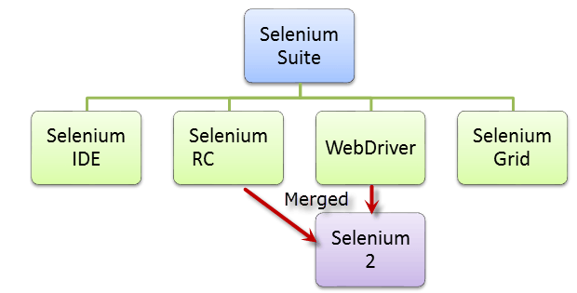
2.1: Introduction To Selenium Landscape and Usage
Selenium is not just a single tool but a suite of software's, each catering to different testing needs of an organization. It has four components:
Notes:
Add the notes here.

Slide 7
2.1: Introduction To Selenium Overview of Selenium IDE
Firefox plug in, allows you to record, play back, edit, and debug tests in browser.
Allows you to record user actions on browser window.
Generate scripts from recorded user actions in most of the popular languages like Java, C#, Perl, Ruby etc. However to run them in an automated testing fashion you need to use Selenium Web Driver.
Selenium default scripts are html (added JavaScript) and that is the script we are going to use it in selenium IDE
The reason for availability of other language is, user can get the scripts for Selenium WebDriver/RC.
It also has a context menu (right-click) integrated with the Firefox browser, which allows the user to pick from a list of assertions and verifications for the selected location

Slide 8
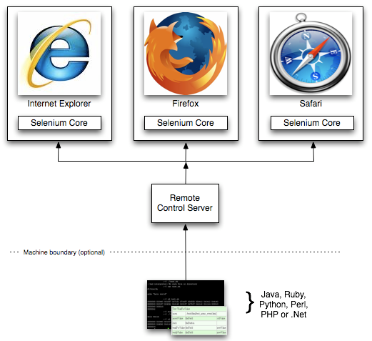
2.1: Introduction To Selenium Selenium Remote Control (Selenium 1.0)
Selenium Remote Control (RC) is a test tool that allows you to write automated web application UI tests in any programming language against any HTTP website using any mainstream JavaScript-enabled browser.
Selenium RC comes in two parts:
A server which automatically launches and kills browsers, and acts as a HTTP proxy for web requests from them.
Client libraries for your favorite computer language.

Slide 9
2.1: Introduction To Selenium Selenium Web Driver (Selenium 2.0)
Selenium WebDriver proves itself to be better than both Selenium IDE and Selenium RC in many aspects.
It implements a more modern and stable approach in automating the browser's actions.
WebDriver, unlike Selenium RC, does not rely on JavaScript for automation.
It controls the browser by directly communicating to it.

Slide 10
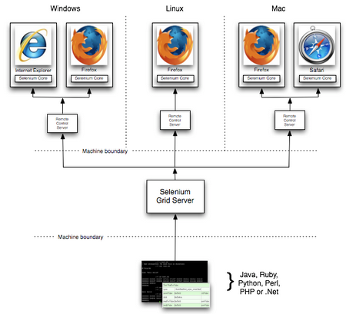
2.1: Introduction To Selenium Selenium Grid
Runs multiple tests on different machines against different browsers and operating systems in parallel
Support s distributed test execution.
Run tests in a distributed test execution environment

Slide 11
Summary
In this lesson, you have learnt
Selenium is a free (open source) automated testing suite for web applications across different browsers and platforms
Selenium is a collection of different tools
Selenium IDE, a Firefox add-on that you can only use in creating relatively simple test cases and test suites
Selenium RC allows users to use programming languages in creating complex tests
WebDriver, allows test scripts to communicate directly to the browser, thereby controlling it from the OS level.
Selenium Grid is used with Selenium RC to execute parallel tests across different browsers and operating systems.
Notes:
Add the notes here.

Slide 12
Review Question
Question 1
Select the component which is NOT part of Selenium suite
Selenium IDE
Selenium RC
Selenium Grid
Selenium Web
Question 2: True/False
Selenium is a set of tools that supports rapid development of test automation scripts for web based applications.
Question 3: Fill in the Blanks
WebDriver, unlike Selenium RC, does not rely on _________ for automation.

